Slide 1
Sensory Overload
Tracking Wearable Device
Damian Ortizflores, Alejandro Ibarra, Edin Latic, Lauren Craig

Slide 2
Sensory Overload
-Occurs in people with:
Autism, anxiety, PTSD, sensory processing disorders, etc.
-Prevention assists with:
Focusing, stressful situations, and anxiety attacks
-Sensory overload can affect any of the senses:
Sight, touch, hearing, taste, and smell.

Slide 3
Sensory Overload Prevention
Goals: Predict and alert sensory overload may occur
Intended User: Caretaker or Individual with Autism, anxiety, PTSD, sensory processing disorders, etc.
User Interface: App displays environmental indicators with various ranges of acceptable and potential overload ranges.

Slide 4
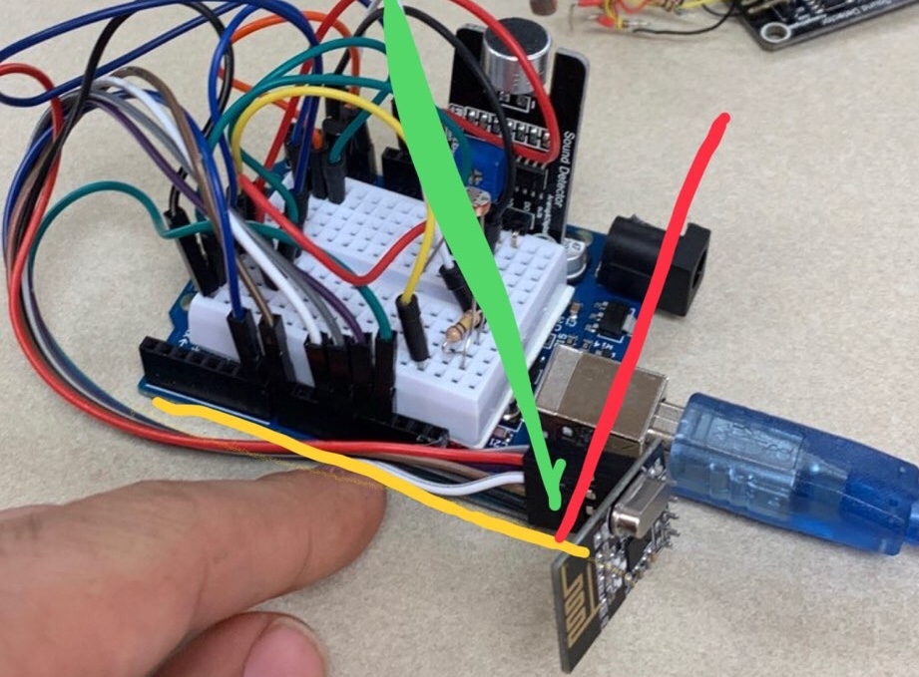
Technology Used
Two Arduino UNOs (One Transceiver and One Receiver)
Two Arduino NRF24L01+ 2.4GHz Wireless RF Transceivers
Sound Detector Microphone
10K Thermistor
Photoresistor
Processing-User Interface Application

Slide 5
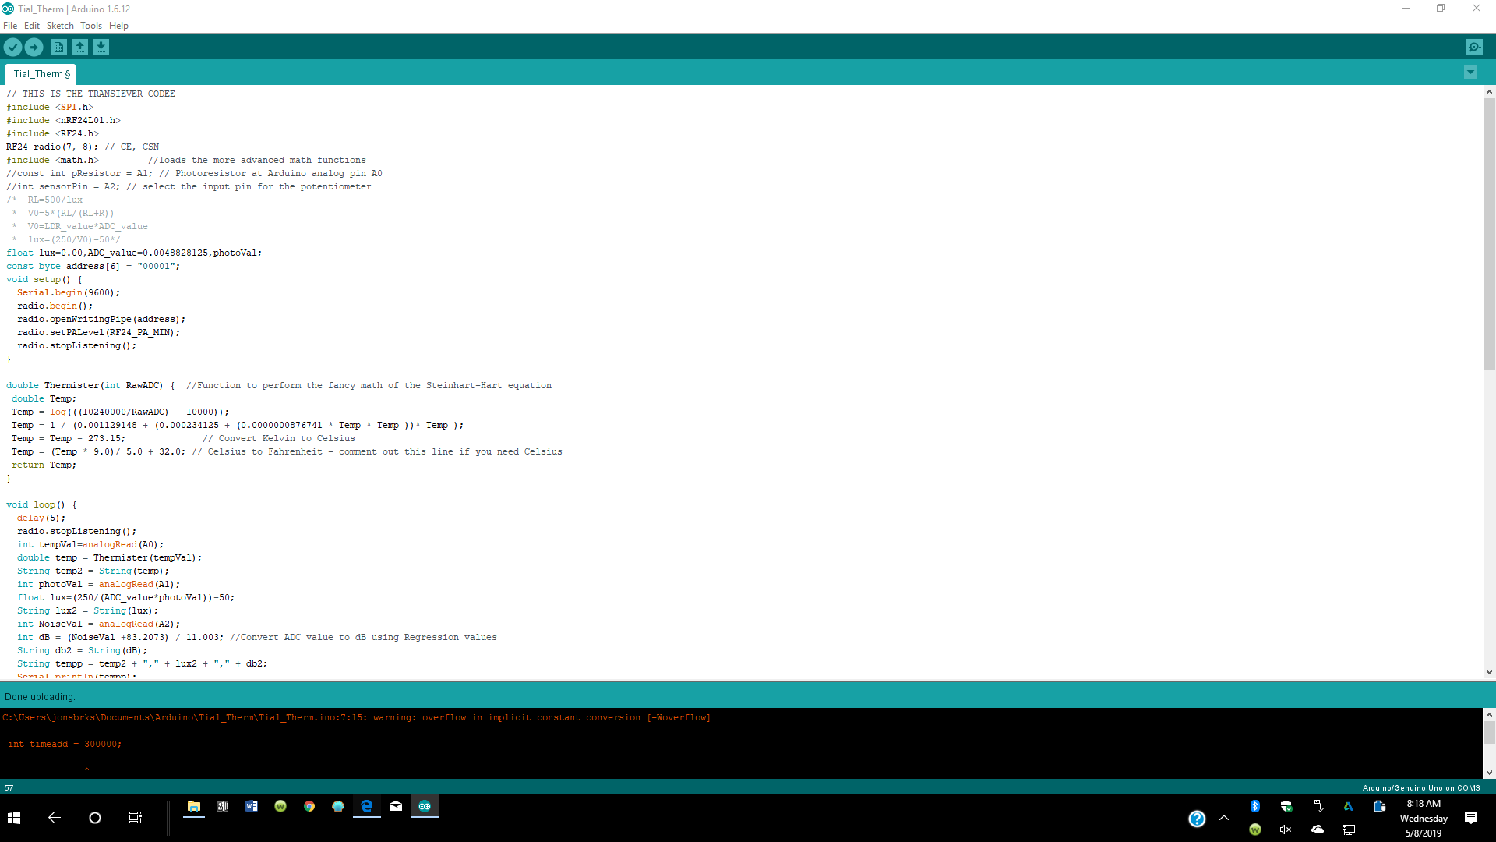
Arduino Code

Slide 6
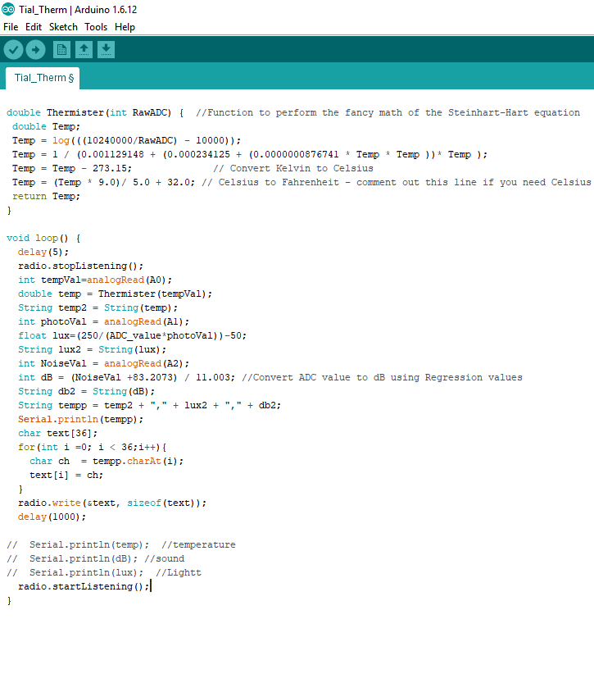
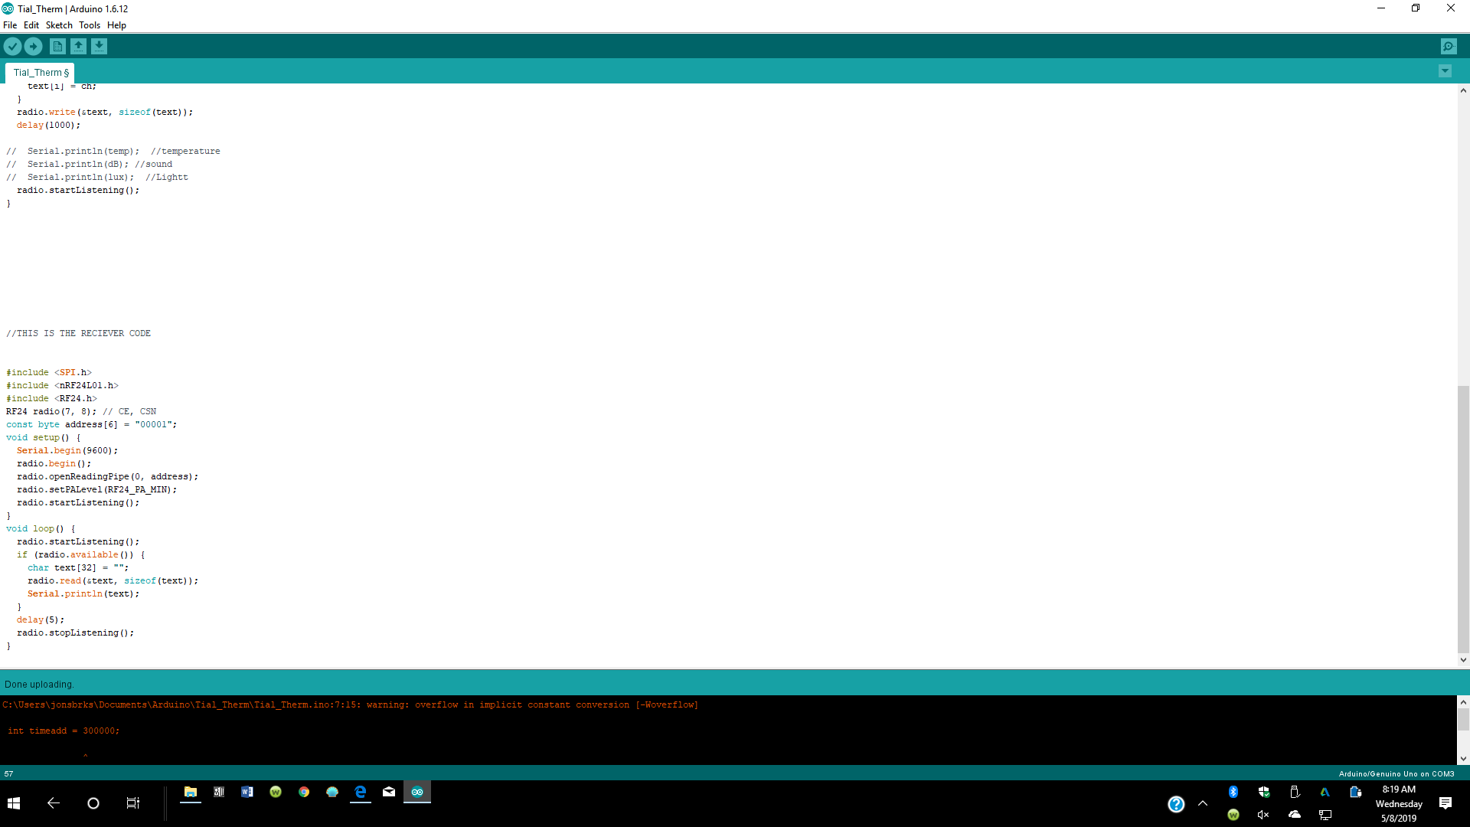
Arduino Code

Slide 7
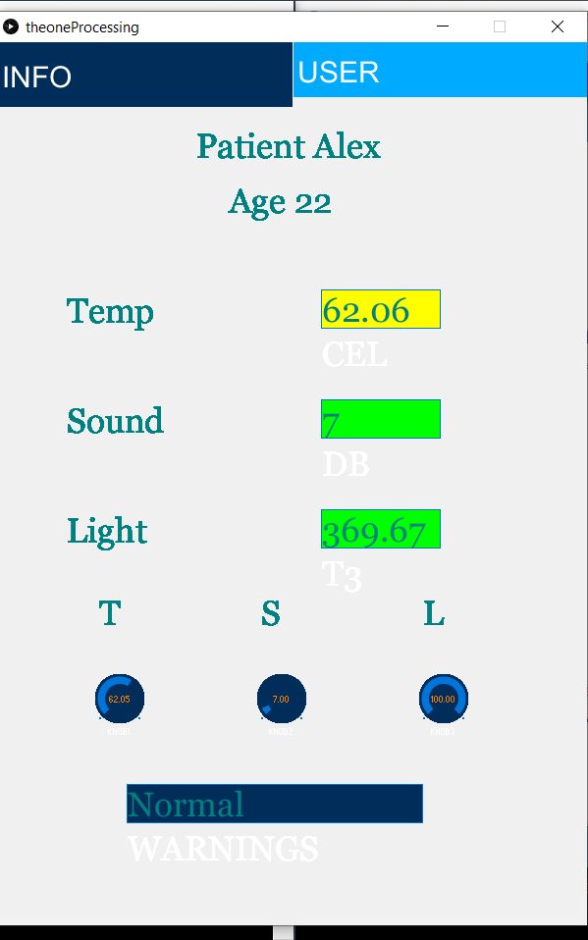
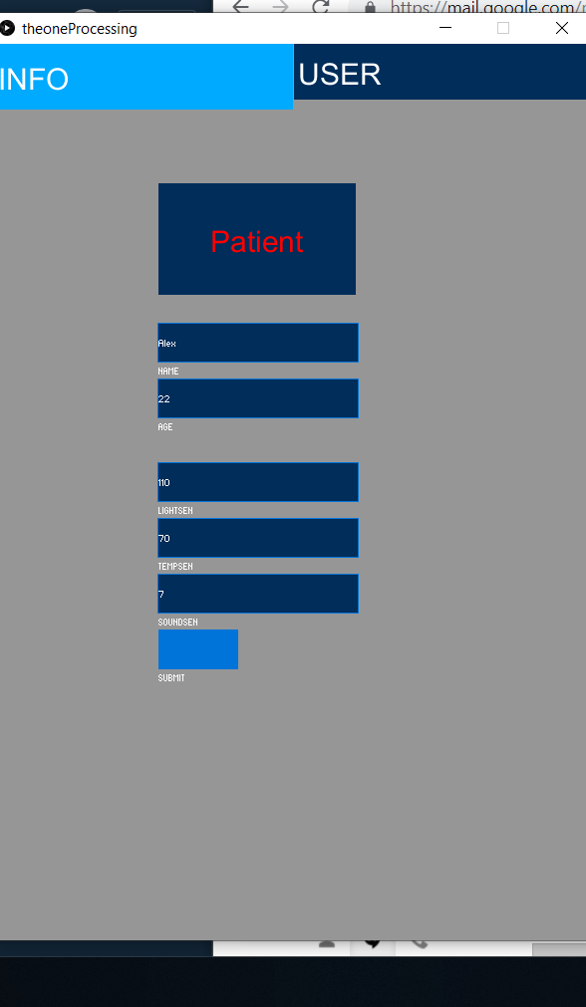
Processing Application

Slide 8
References
[1] Healthline. “What Is Sensory Overload?” ​Healthline​, Healthline, www.healthline.com/health/sensory-overload#examples.

